Slide 1


CELESTIAL
AND CHILL
Your Space to Binge!

Slide 2
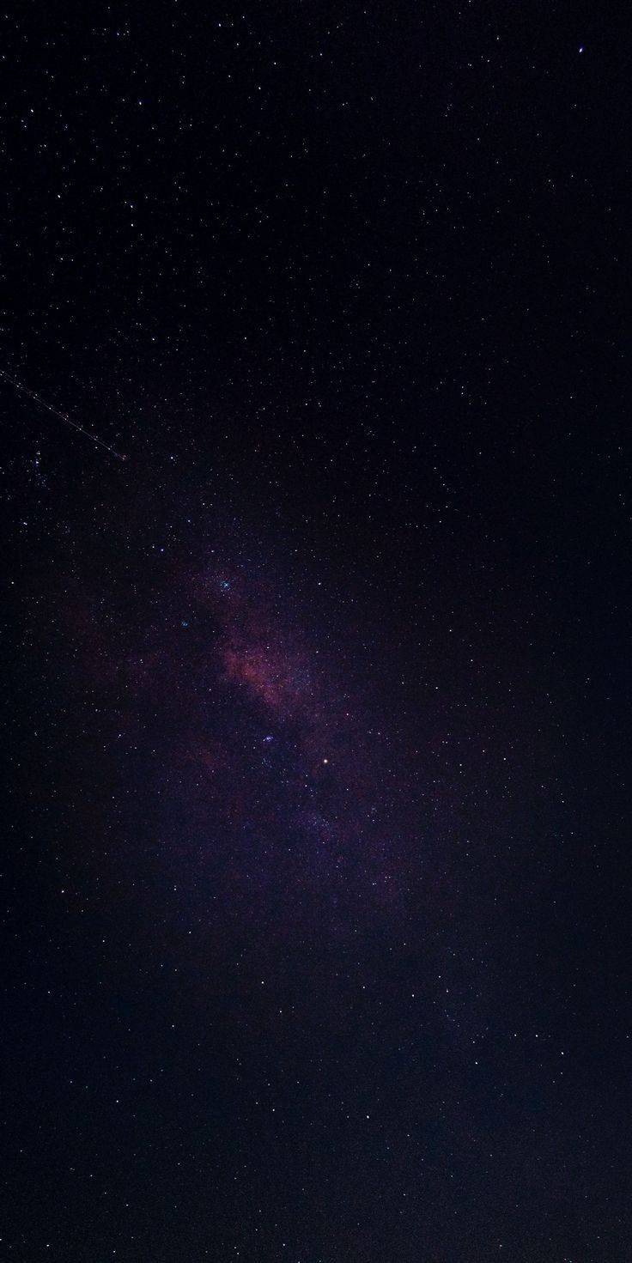
Introduction to challenge & Problem Statement
To design a celestial-themed user interface for a streaming platform that replicates the features and functionality of Netflix. The UI was to include easy navigation, visually appealing images and videos, personalized recommendations, user-friendly search functionality, and intuitive categorization of content. The celestial theme should be integrated throughout the UI, with a colour scheme and visual design that is consistent and visually appealing.

Slide 3
Research and inspiration
behind the design
Celestial Based Design
Colour Palettes
Interactive Elements
The prime inspiration for our project was the outside world.
Used celestial images and patterns in our design.
The usage of colours such as dark blues, purples, and black evoke a celestial feel and add to the uniqueness of the interface.
Used animations such as rockets and enabled hovering over icons to incorporate a more futuristic touch to the project.

Slide 4
Research and inspiration
behind the design
We created wireframes and sketches to plan out the layout, navigation, and interactive elements of the design. We learnt the basics of figma using YouTube and recreated the design.
Design
Prototyping
Selling
We created a prototype of the design and tested it to identify any usability issues and thus made necessary changes and improvements to the design based on the feedback.
We then finalized the design and added icons and graphics. We ensured that the final design is user-friendly, visually appealing, and meets the needs of the target audience.

Slide 5
DESIGN SYSTEM
Typography
Typography
Arimo
Primary Font
Bebas neue
Secondary Font
Aa
Aa
Colour Palette
ABCDEFGHIJKLMNOPQ
RSTUVWXYZ
ABCDEFGHIJKLMNOPQRSTUVWXYZ
0123456789?!%&
ABCDEFGHIJKLMNOPQ
RSTUVWXYZ
ABCDEFGHIJKLMNOPQRSTUVWXYZ
0123456789?!%&
HEX-#A91344
HEX-#6A4A86
HEX-#27426F

Slide 6


OVERVIEW OF THE
DESIGN AND ITS FEATURES
Accessibility page
Aims to accommodate people with different disabilities such as visual or hearing impairments by including features like subtitles and audios in different languages. A read-aloud icon is provided on the top right corner for the visually impaired.
TV-Shows and Movie Pages
On hovering over a specific show/movie, a preview consisting of the plot synopsis and features like watchlist, watch-party appear. An X-Ray option showing cast and crew information as well as interesting trivia.

Slide 7


OVERVIEW OF THE
DESIGN AND ITS FEATURES
Homepage
Interactive Elements
features a space- themed background, with various rows of recommended shows and movies based on the user's viewing history.
The design features various interactive elements, like hover effects, animations, and celestial-themed icons to make the user experience more engaging.
Collaborative
Search & Sort
We have added a unique feature for users to make collaborative watchlists with their friends so that it is easier to select movies during watch parties.
On clicking the search bar, we are provided with different sorting parameters including genre, IMDB rating, duration, audio language to make the interface more user-friendly.

Slide 8




OVERVIEW OF THE
DESIGN AND ITS FEATURES
Settings
Mood
The settings page would allow users to manage their account, toggle email notifications, accessibility and change their passwords.
We have also added a category based on the different moods of a user such as happy, sad, romantic etc to make it more customizable.
Watchlist
Watchparty
We have incorporated a feature that enables users to add movies and TV shows to their watchlist, so they don't miss out on any of the fun!
This feature allows users to chat and watch movies and tv-shows with friends and family virtually.

Slide 9

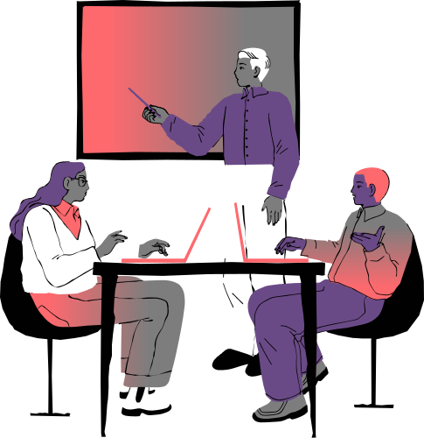

Design Iterations and Rationale

Slide 10
We made a lot of changes to what we initially thought our design would look like,
For the horizontal scrolling on the homepage, we initially wanted the arrows to scroll on clicking but after playing it we realised that we should only keep arrows as in indication of the scrolling feature existiing.
Initially we were only including features already on netflix but we then decided to add some of our own and also add some features from amazon prime.
Instead of our original decision to show content description on hovering, we decided to show the description on clicking as it made the interface easier to comprehend.

Slide 11


USER FEEDBACK
When playing any movie, an X-Ray feature appears which shows the cast of the movie/tv-show and trivia about the movie.
Converts the Netflix watch party chrome extension into a feature within the app itself.It is placed next to the add to Watchlist icon.
Redirects to the home page by clicking the back arrow icon on any of the pages.

Slide 12




TESTING RESULTS
We incorporated transitions across frames such as instant, dissolve and smart animate to make the interface more user friendly.
We encountered several bugs such as dis-functional buttons and vary animations during runs and fixed them via thorough testing.
Scrolling was a tricky bit as we had to incorporate vertical scroll to the page and horizontal scroll to nested frames, that we learnt via hit and trial.

Slide 13
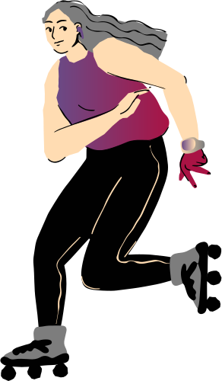

Challenges we faced
Prototyping
Horizontal scrolling
Animations

Slide 14
CHALLENGES FACED AND HOW THEY WERE OVERCOME
Prototyping
Horizontal scrolling
Animation
The prototype of the slides was complicated for us to design as we had to learn it from scratch. However we managed to complete it by performing dry runs and logically approaching each connection.
We intially found it quite difficult to add animation to objects. We later overcame this by designing the rocket using smart animation,time lapse, etc
It was difficult for us to incorporate horizontal scrolling for the movies on the main page. We researched a lot and found a solution involving making a frame inside a frame.

Slide 15

FUTURE IMPROVEMENTS
Notification Pa﻿ge
Responsiveness
We can add a notification bar in our app to get notifications about trending or latest movies/series.
Due to time constraints, we were unable to make the app compatible across different devices. We would like to resolve this issue in the feature,

Slide 16

Your space to binge!

Slide 17
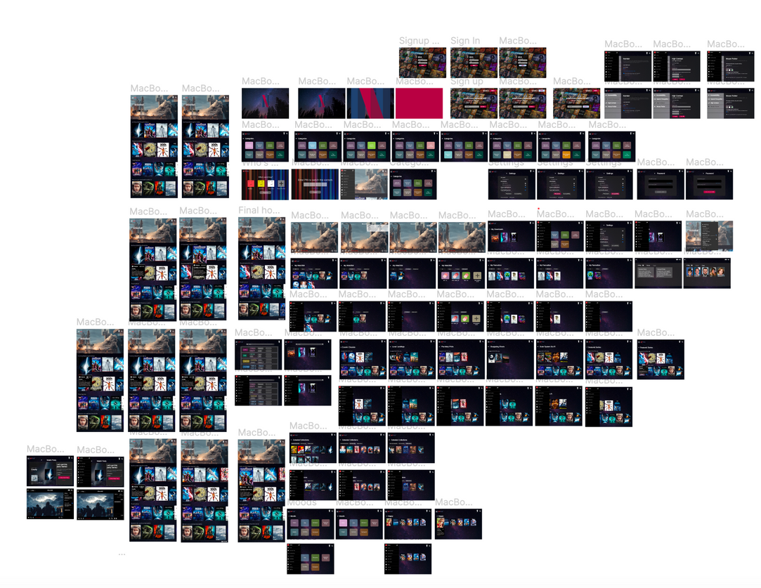
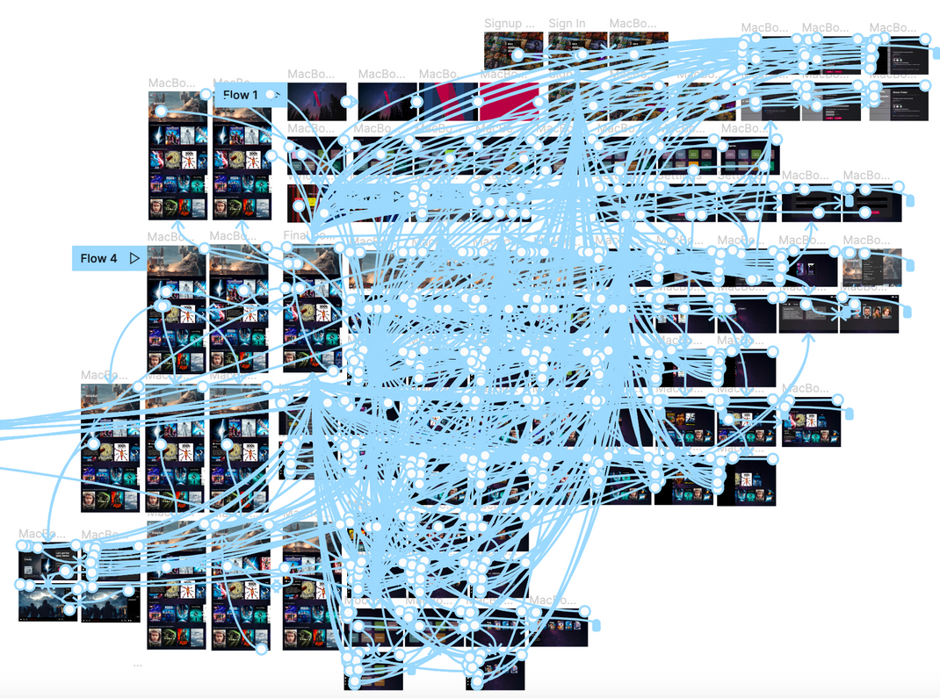
Figma Workspace
Frames
Prototyping

Slide 18
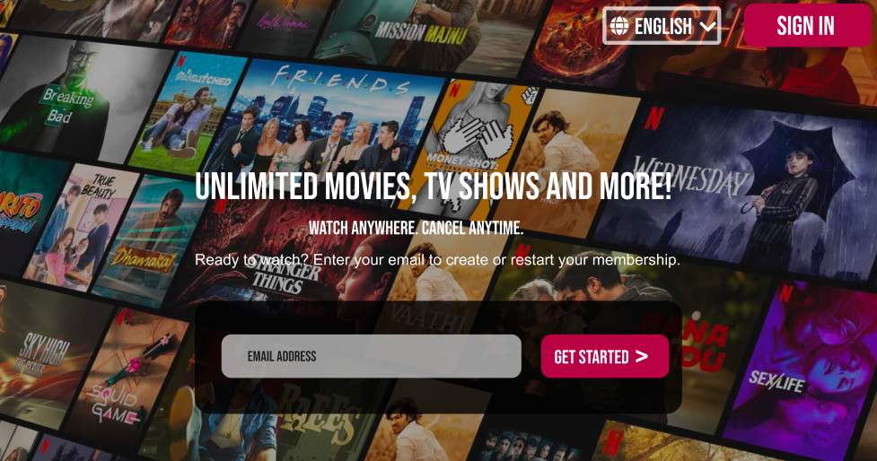

Sign Up Page

Slide 19
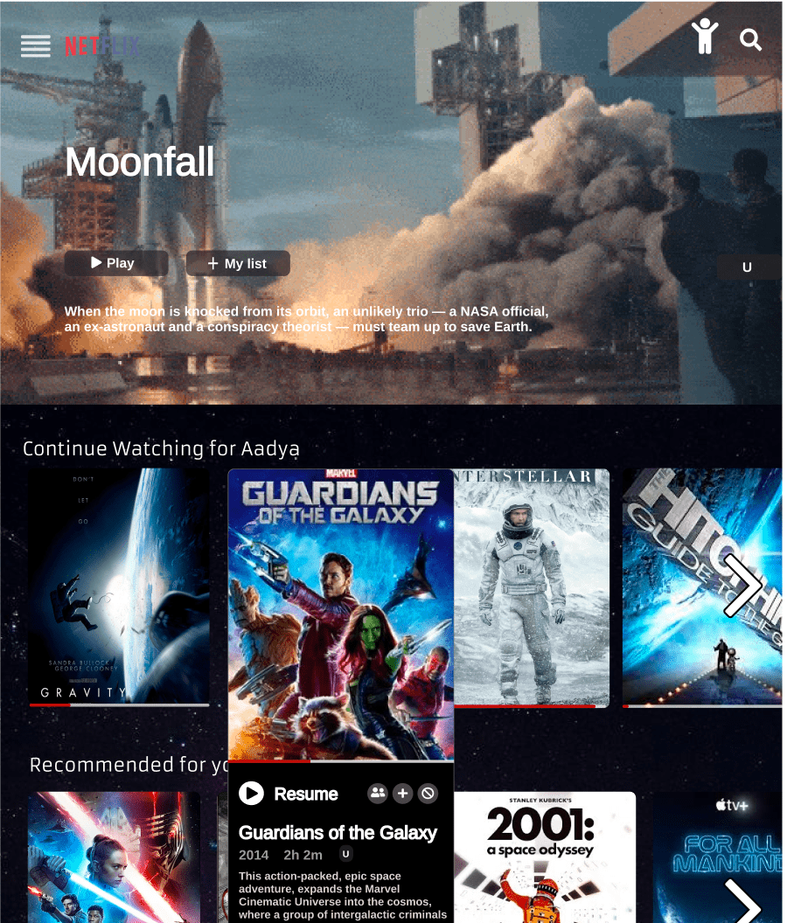
Main
Homepage
The main homepage is displayed once the user logs in. It displays personalised content based on the users' watch history.
On hovering over movies the posters expand into a brief description of the film, along with the watch party, add to watchlist and hide options.

Slide 20
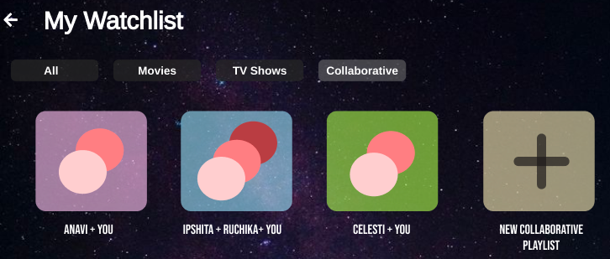
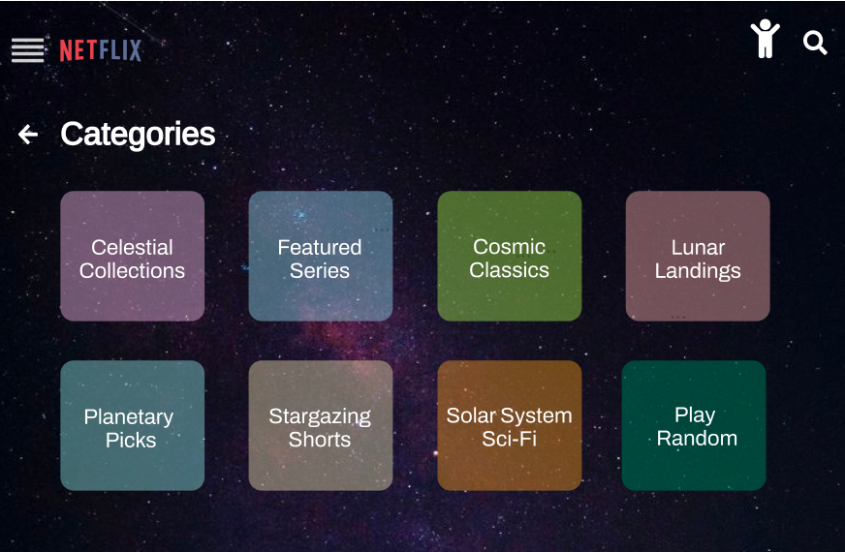
Watchlist
This is the collaborative watchlist section which allows users to make playlists with their friends on the platform itself!
Categories
We have tried to include categories of space based content to add a celestial touch. We have also included a Play Random feature.

Slide 21
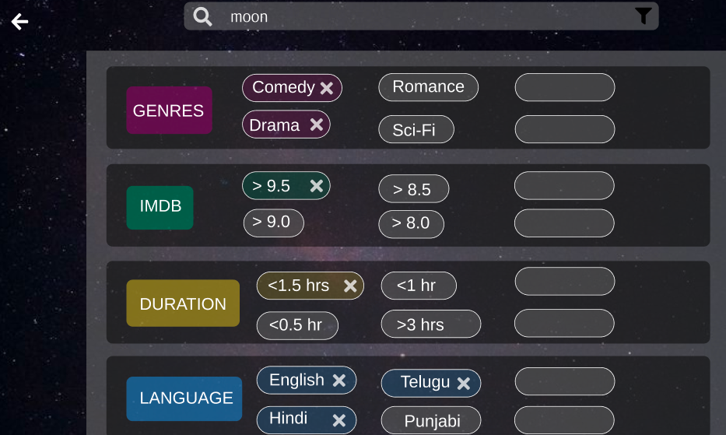
Search and
Filter
We introduced a feature wherein the user can search use tags. These can be multiple genres, imdb ratings, durations, language etc.

Slide 22
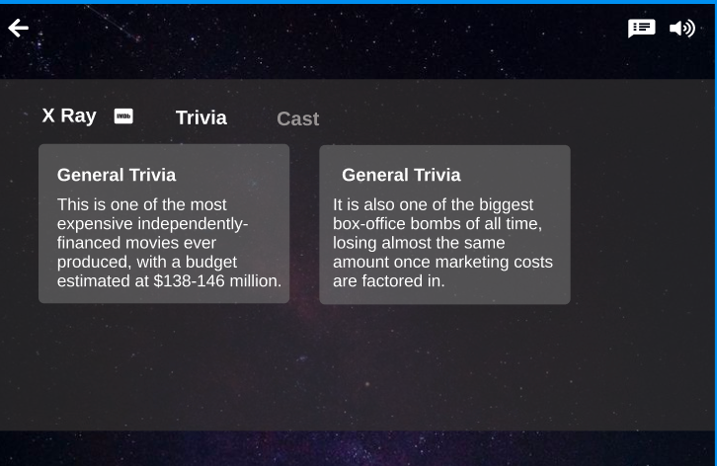
X-Ray
Feature
The X-Ray feature depicts cast details and general trivia about the respective film.

Slide 23
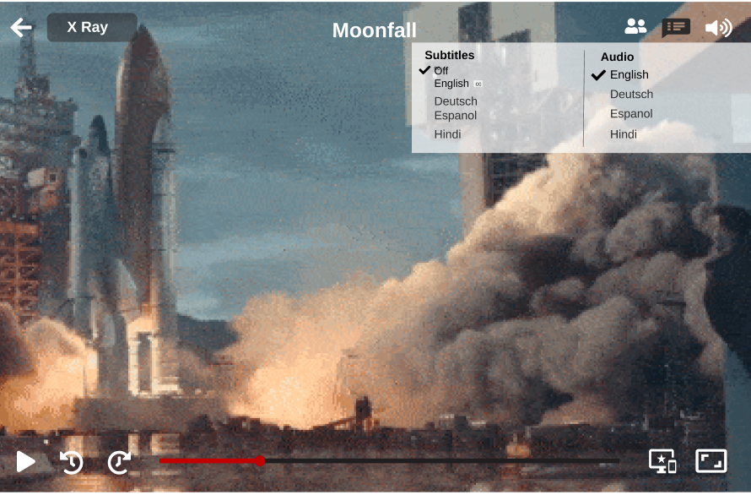
Play
On pressing the play button, the movie begins to play.
Navigations for X-Ray, watchparty, subtitles and volume control have been added to enhance user experience.

Slide 24
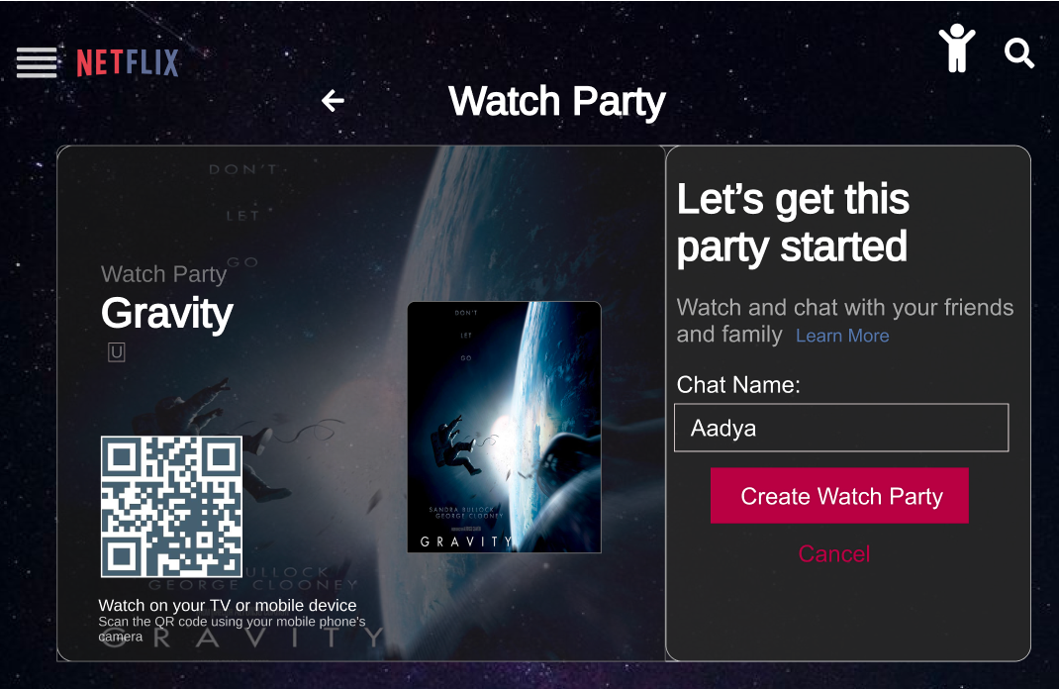
Watch
Party
This feature enables us to watch with our friends and chat with them while watching!

Slide 25
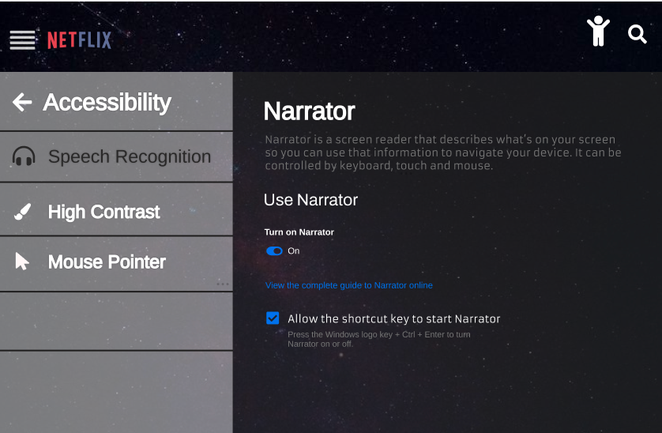
Accessibility
We have tried to include as many features as possible for the visually and hearing impaired so as to make our platform friendly for all users.

Slide 26
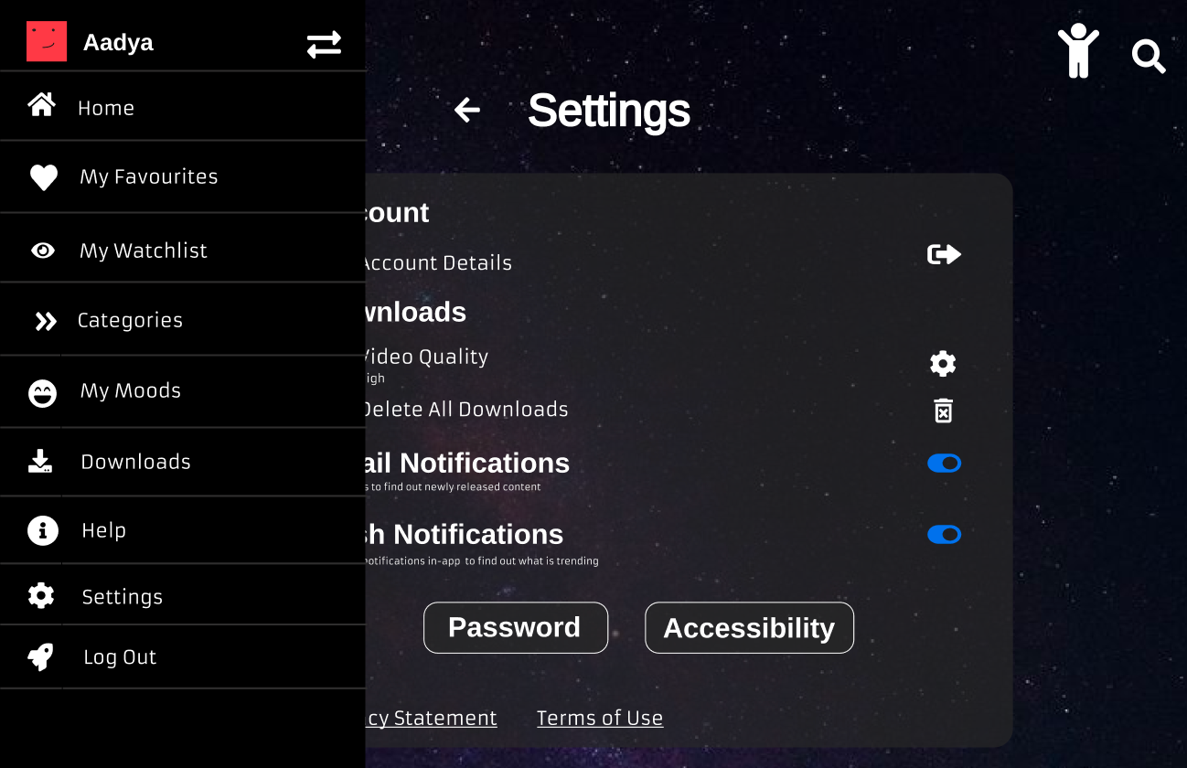
Settings and
side drawer
We have included the necessary options in settings and made a side drawer for all pages to make the navigation simpler.

